Slide 1
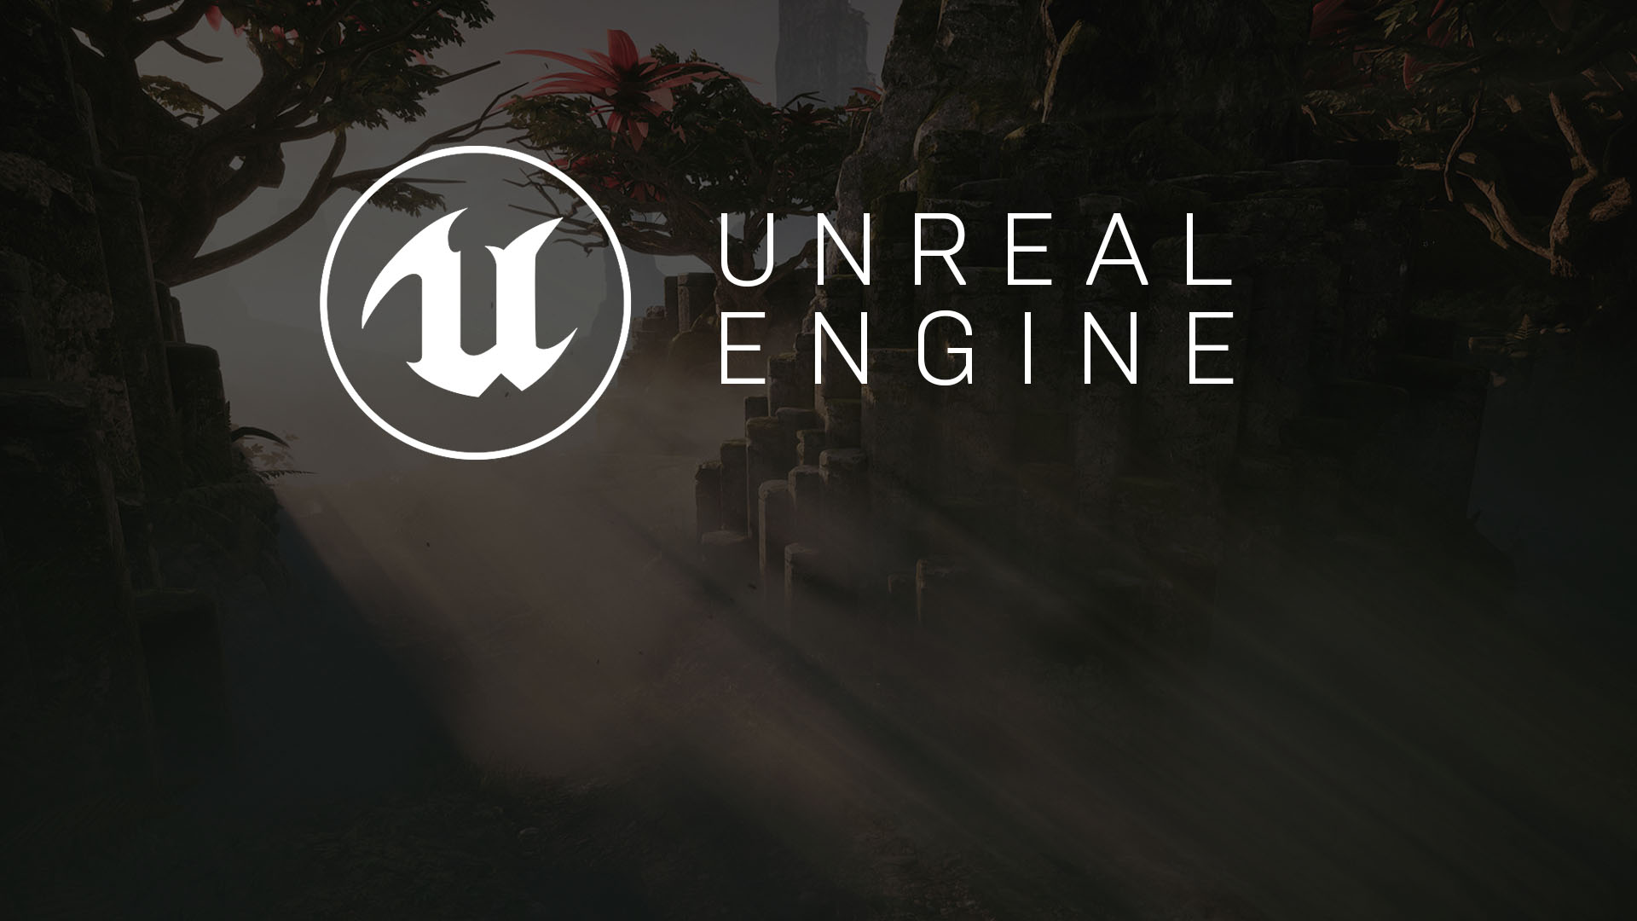
hour 23
Making an Executable:
How to Package and Cook Your Project

Slide 2

introduction
While the Unreal Engine 4 Editor lets you play, preview, and test your projects, eventually you will need to distribute the projects to other people. This lecture covers how to cook and package content and create executables.

Slide 3
Lecture Goals and Outcomes
Goals
Outcomes
The goals of this lecture are to
Understand the difference between cooked and uncooked content
Learn how to package a project for a Windows OS environment
Learn about the advanced packaging settings
By the end of this lecture you will be able to
Cook content
Package a project
Make an executable

Slide 4
Packaging
Overview

Slide 5
Target platforms
Before an Unreal project can be distributed to users, it must be properly packaged. Packaging ensures that all code and content are up to date and in the proper format to run on the desired target platform.

Slide 6
Compile custom source code
Compile Blueprints
Cook content
Bundle compiled code and cooked content
Save to staging folder
Packaging Process
A number of steps are performed during the packaging process. When a project has custom source code, this code will first be compiled. Then all required content will be converted, or “cooked,” into a format that can be used by the target platform. After that, compiled code and cooked content will be bundled into a distributable set of files, such as an installer for Windows.

Slide 7
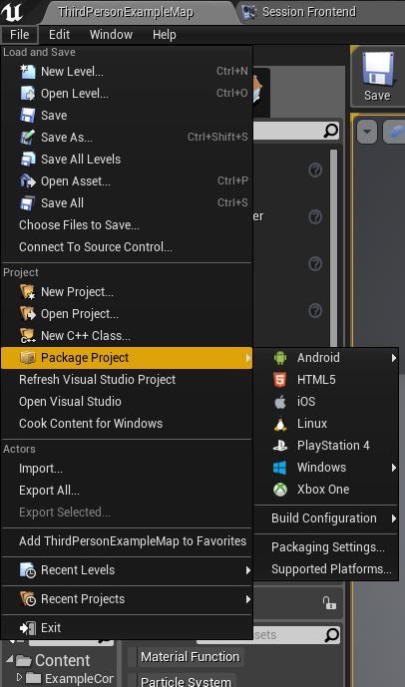
Packaging Process
Under the main File menu, there is an option called Package Project, with a submenu. This submenu shows all the platforms that you can prepare a package for.
The purpose of packaging is to test your full game instead of a single map, or to prepare your game for submission or distribution.

Slide 8
Creating a Package
Walkthrough

Slide 9
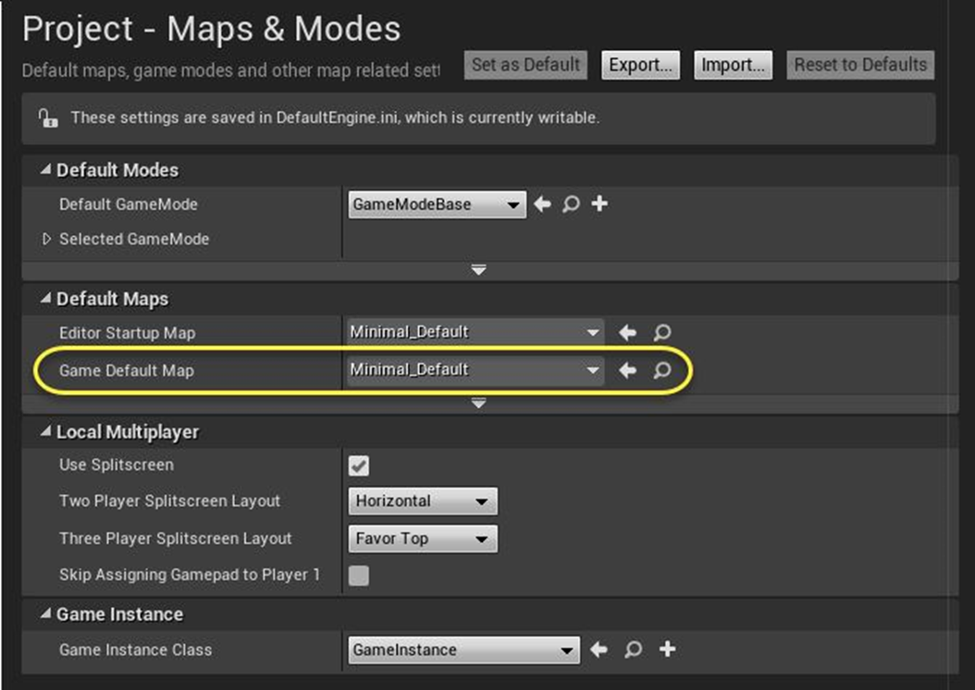
Setting A Game
Default Map
Before packaging your game, you will first need to set a game default map, which will load when your packaged game starts.
To set the game default map,
Click on Edit > Project Settings > Maps & Modes in the Editor’s main menu.
Click on the Game Default Map property triangle.
Select the desired map.

Slide 10
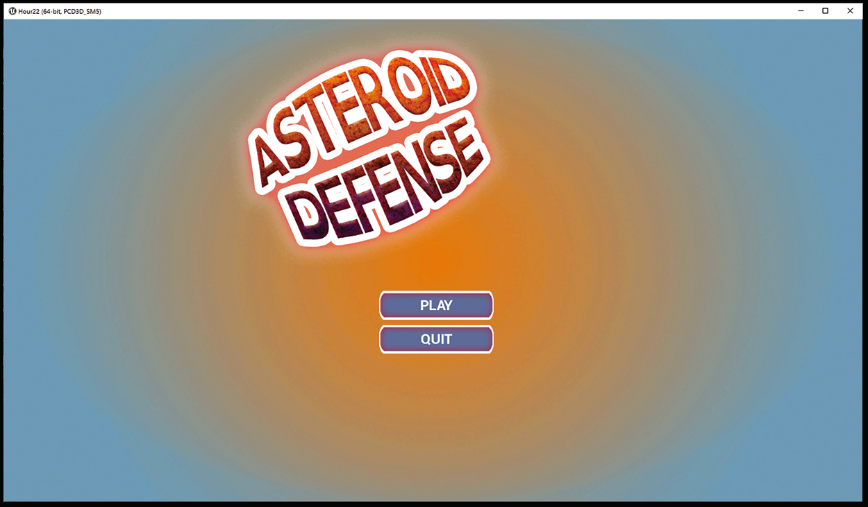
Typically the default map should be a map that displays a start menu or a main interface made with UMG, but it can be any playable map.
If you do not set a map and are using a blank project, you will only see a black screen when the packaged game starts. If you have used one of the template maps, such as the First Person template or Third Person template, the starting map will be loaded.

Slide 11
Build Configurations
There are a few different build configurations, but Development and Shipping are easily accessed by going to File > Package Project > Build Configuration.
Build Configuration | Description
Shipping | This is the configuration for optimal performance and for shipping your game. It strips out console commands, stats, and profiling tools.
Development | This configuration is equivalent to Release. Unreal Editor uses the Development configuration by default. Compiling your project using the Development configuration enables you to see code changes made to your project reflected in the Editor.

Slide 12
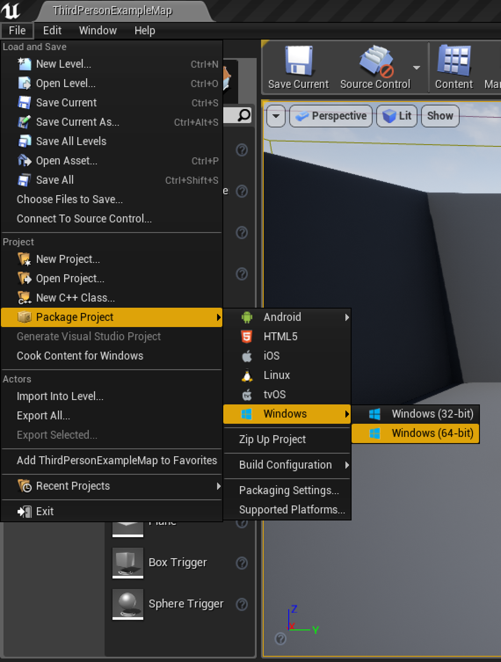
Creating Packages
To package a project for a specific platform, click on File > Package Project in the Editor’s main menu and select the platform.
In the example on the right, a package is being created for Windows (64-bit).

Slide 13
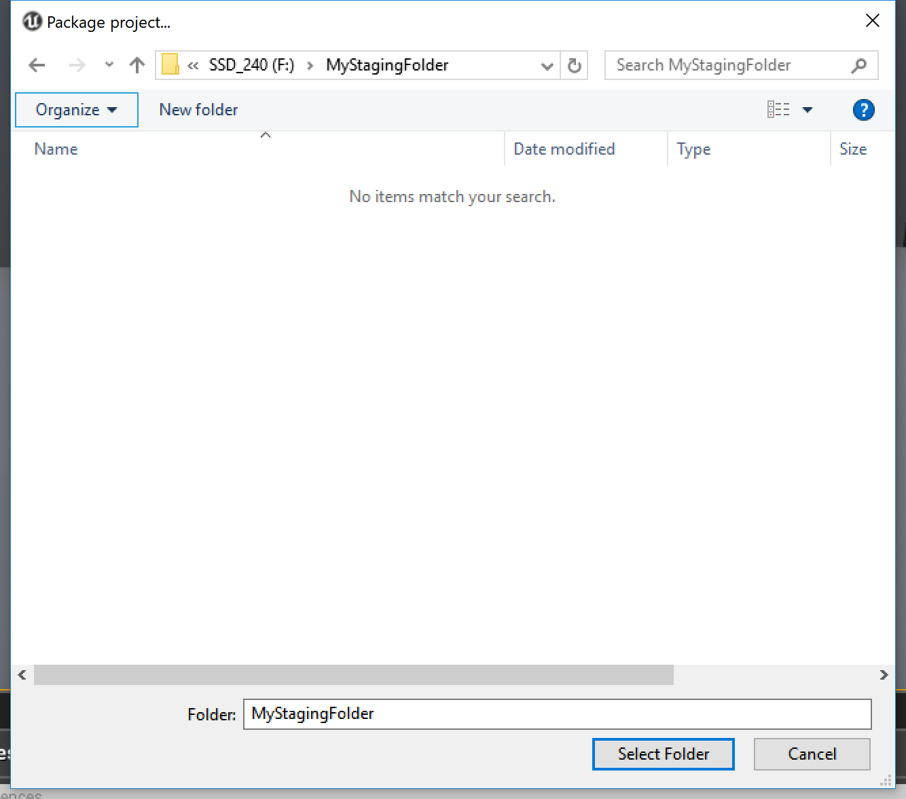
Selecting a
staging folder
You will be presented with a dialog for selecting the target directory (staging folder). If packaging completes successfully, this directory will contain the packaged project.

Slide 14

Confirming the target directory will initiate the actual packaging process.
Because packaging can be very time consuming, the process is executed in the background, and you can continue to use the Editor.
A status indicator will be displayed in the bottom right corner of the Editor to indicate the progress.
The status indicator provides a way to cancel the active packaging process by clicking the Cancel button.

Slide 15
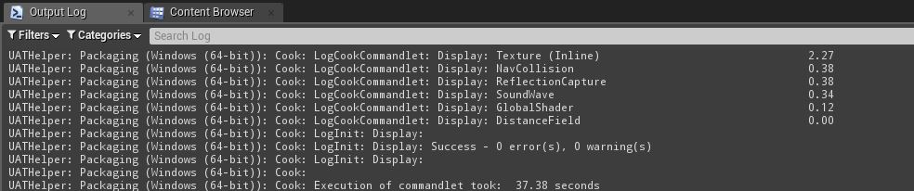
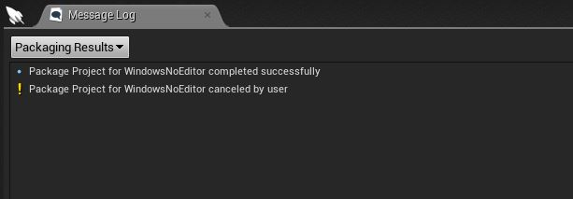
Displaying log information
To display extended output log information, click the Show Log link. The output log is useful for figuring out what went wrong when a packaging process does not complete successfully.
The most important log messages, such as errors and warnings, are also logged to the regular Message Log window:
This window can be accessed by going to Window > Developer Tools > Output Log / Message Log.

Slide 16
Cooking Content
Process

Slide 17
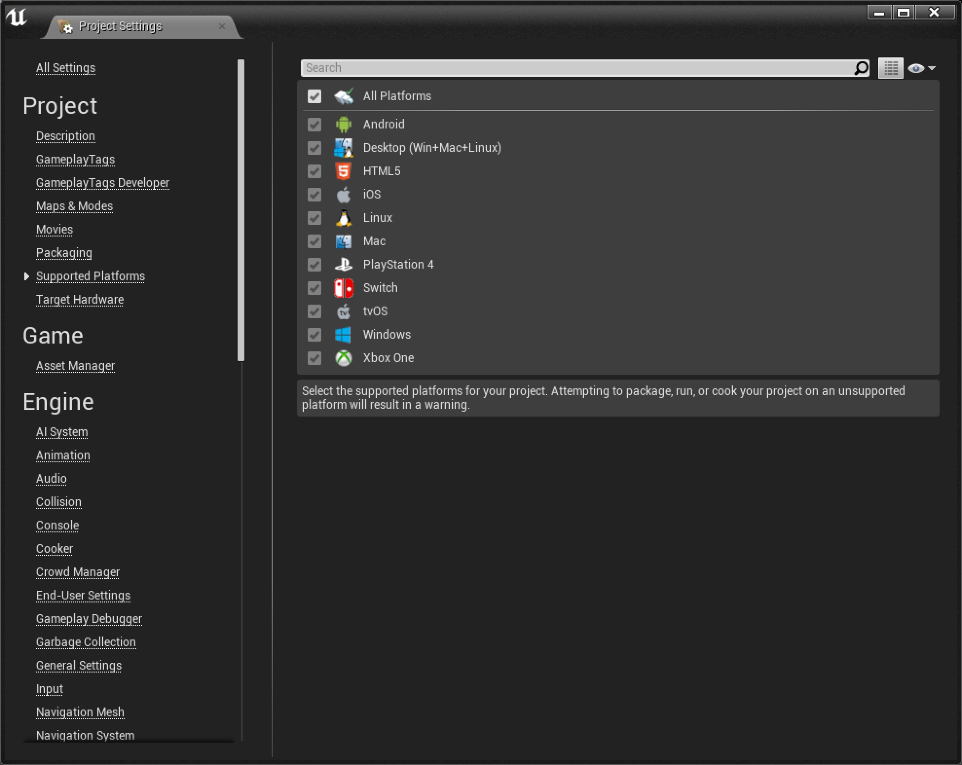
Cooking Content
As you already know, when working in the Editor, content is stored as .uasset and .umap files. Cooking is basically a conversion process that removes Editor-specific data from the assets.

Slide 18
Cooking Content
The Editor can create builds for a wide range of target platforms. The cooking process prepares different versions of assets for different platforms. The cooking stage ensures that content is usable on the target device.

Slide 19
Compiling Blueprints
Checking for errors
Ensuring all shaders are completely compiled
Checking for missing assets in Levels that are being cooked
Cooking Content
The cooking process ensures that a project is ready for packaging and is not missing anything that can cause problems later. The process involves a number of steps that help prevent bugs:
Compiling Blueprints
Checking for errors
Ensuring all shaders are completely compiled
Checking for missing assets in Levels that are being cooked

Slide 20
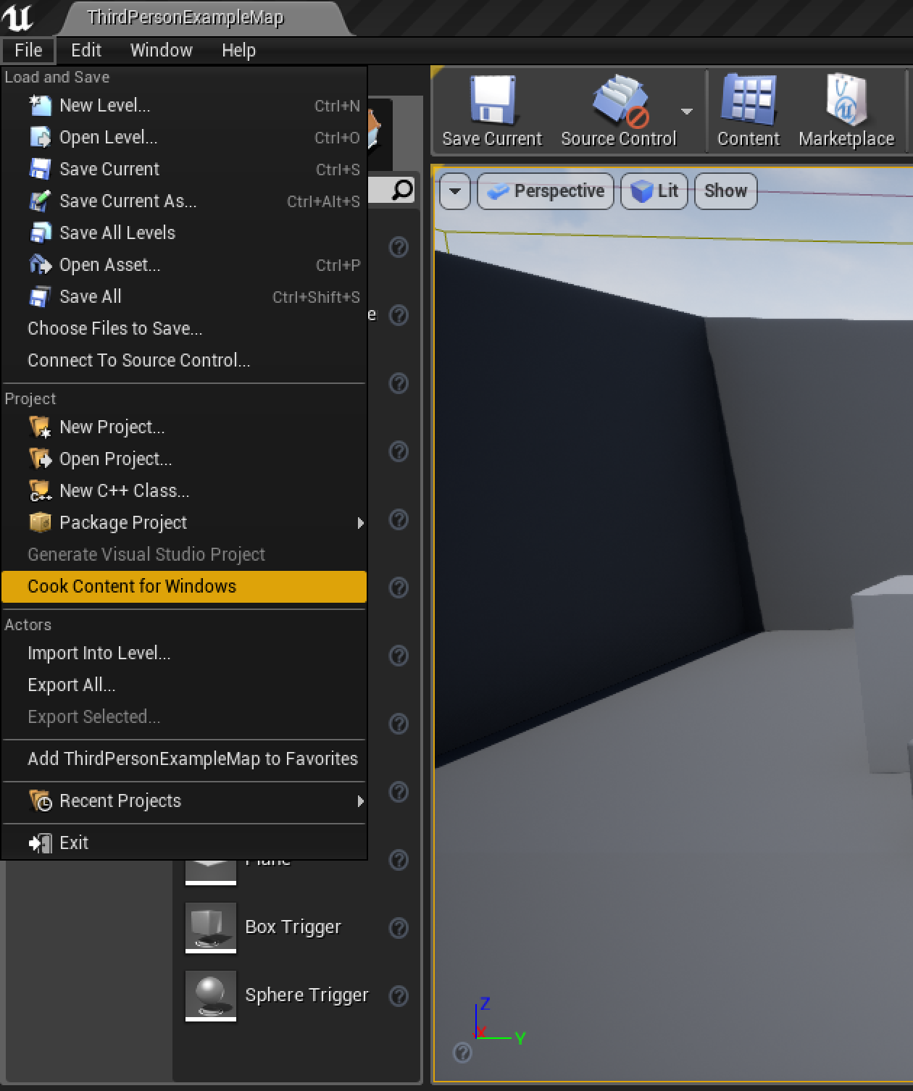
Cooking Content
While cooking is part of the packaging process already, it can also be performed independently by going to File > Cook Content for Windows.

Slide 21
Packaging
Advanced Settings

Slide 22
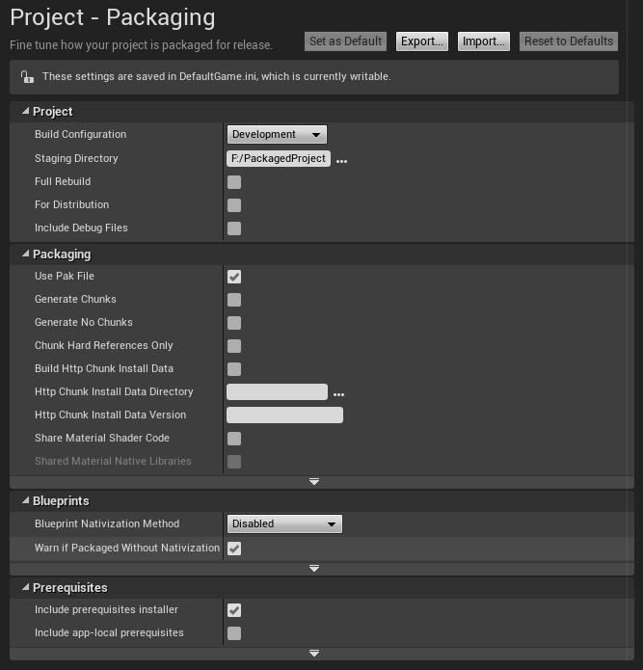
Advanced Settings
While the Editor has exposed the most commonly used elements for packaging a project, there are advanced settings.
Clicking File > Package Project > Packaging Settings or selecting Edit > Project Settings > Packaging in the main menu will present you with a number of advanced configuration options for the Packaging feature.

Slide 23
Option | Description
Build Configuration | Sets the build configuration to compile your code-based project with. For debugging a code project, select DebugGame. Note that Blueprint-only projects will not have this option. For most other development with minimal debugging support, but better performance, select Development. For the final shipping build, which will have no debugging information and no debugging-oriented features (such as drawing debug shapes or printing debug messages on the screen), select Shipping.
Staging Directory | Sets the directory that will contain your packaged build. This will be updated automatically when you pick a different directory in the target directory selection.
Full Rebuild | Sets whether all of your code should be compiled. If disabled, only the modified code will be compiled, which may speed up the packaging process. For shipping builds, you should always do a full rebuild to make sure nothing is missing or outdated. This option is enabled by default.
Use Pak File | Sets whether to package your project’s assets as individual files or as a single package. If enabled, all assets will be put into a single .pak file instead of copied out as individual files. If your project has a lot of asset files, using a PAK may make it easier to distribute it, because you do not have to transfer so many files. This option is disabled by default.
Generate Chunks | Sets whether to generate .pak file chunks that can be used for streaming installs.
Build Http Chunk Install Data | Sets whether to generate data for HTTP chunk installer, which allows the data to be hosted on a web server to be installed at runtime.
Http Chunk Install Data Directory | Sets the directory where data will be installed once it is built.
Http Chunk Install Data Version | Sets the version name for HTTP chunk install data.
Include prerequisites installer | Sets whether to include installers for prerequisites of packaged games, such as redistributable operating system components.
Advanced Settings
The advanced settings allow you to micromanage the packaging process.

Slide 24
Blueprint Nativization
Along with cooking content, the packaging process can also “Nativize” Blueprint classes. This process compiles Blueprint scripts for the target hardware and OS.

Slide 25
Because Blueprints run in a virtual machine (VM), they are less efficient than C++.
Making an entire project with Blueprints works well for game teams that don’t have the technical expertise of native C++ programmers. Blueprint nodes run in a virtual machine (VM), enabling them to call native C++ functions. Relying on a VM during runtime comes at a cost, potentially slowing a game’s performance per frame.
When using Blueprint Nativization during the packaging process, the Unreal Automation Tool (UAT) will Nativize the following supported Blueprint assets:
Blueprint classes
Blueprint Function Libraries
Blueprint Interfaces
Anim Blueprints
Widget Blueprints
User-defined structures
User-defined enums

Slide 26
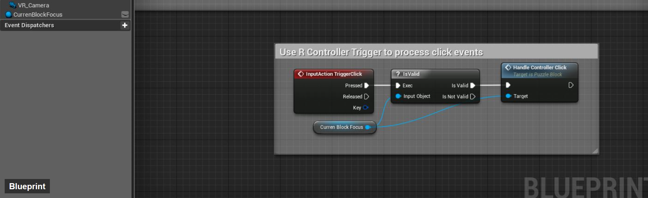
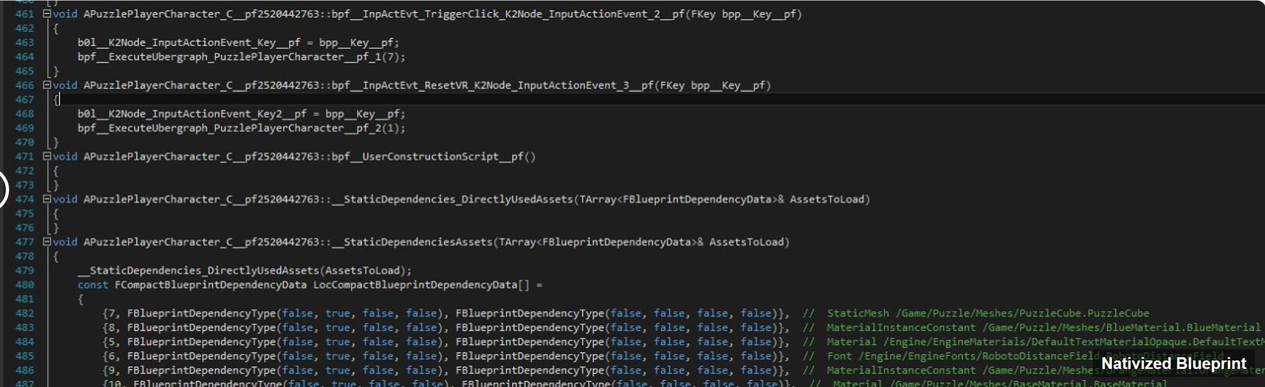
Blueprint Nativization
The main goal of Blueprint Nativization is to reduce VM overhead in the runtime version of your project by generating native C++ code from your project’s Blueprints.
In general, all of the Blueprint classes are replaced by the newly generated native C++ classes, which will then be compiled with the project during the cooking process.
Although you’ll be able to read the translated C++ code from a text editor, you’ll notice that the code isn’t formatted to be reusable (or generated to be “reader friendly”).

Slide 27
Running a Packaged game
WindowsNoEditor

Slide 28
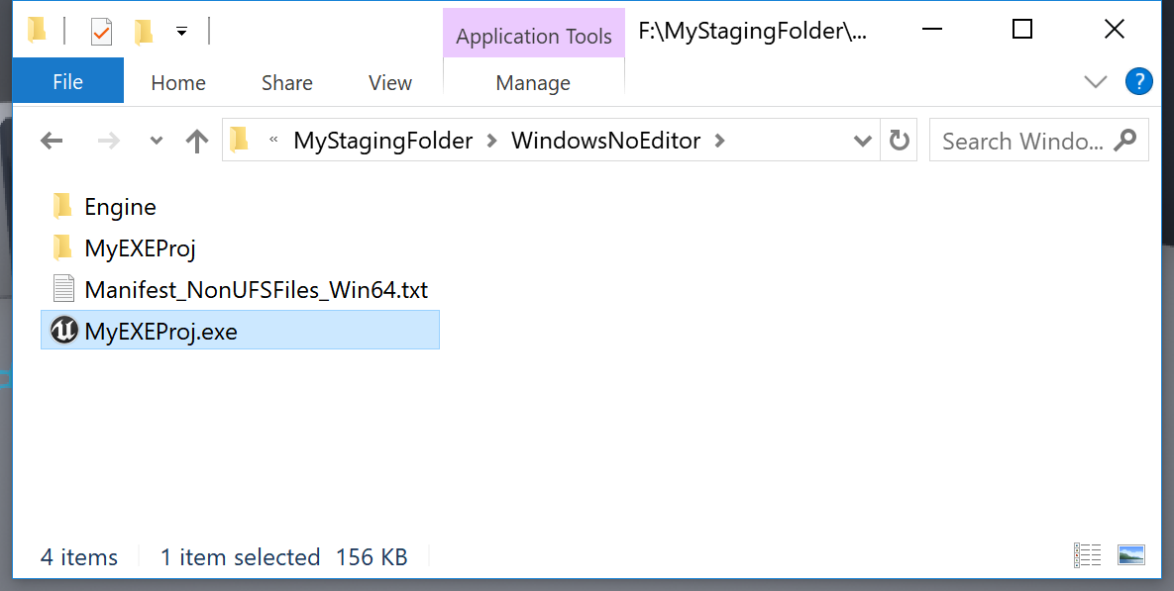
Running Packaged Games
Once a project has been successfully cooked, packaged, and saved to the staging folder, it is ready to run. Navigate to the staging folder, open the WindowsNoEditor folder, and double-click on the .exe file to run the project.

Slide 29
Running Packaged Games
The WindowsNoEditor folder and its entire contents are needed to run the project. You can rename the WindowsNoEditor folder and the .exe file, but nothing else.

Slide 30
Exercise:
Create a New Project and Make an Executable
Create a new blank project with no starter content.
With the project open, add the Third Person template. In the Content Browser, click Add New and select Add Feature or Content Pack.
In the Add Content to the Project window, select Blueprint Feature and the Third Person template and click +Add to Project. Then close the window under Project Settings.
Set Default GameMode to ThirdPersonGameMode.
Set Game Default Map to ThirdPersonExampleMap.
In the main Editor, go to File > Cook Content for Windows.
In the main Editor, go to File > Package Project > Build Configuration and select Development.
In the main Editor, go to File > Package Project > Windows and select Windows (64-bit).
Choose a staging directory.
When finished, navigate to the staging folder and run the .exe file.

